Slide 1
CSCI 2930 Practical System Administration
Lecture 3: Desktops and Tier 1 Support

Slide 2
History – The Never Ending Cycle
Centralized Mainframe running multiple operating systems in a highly redundant system
Access via terminals
Industry moved to distributing compute power to the Desktop and Smaller x86 servers
Server sprawl made datacenters exponentially more expensive to run
Virtualization using x86 hardware to consolidate servers
Virtual Desktops and vBlocks to “save” money

Slide 3
Desktop Components CPU’s
32bit vs 64 bit
Allows the system to address more memory
32bit = 4GB
64bit = 16 Exabytes (in principle)
Most RISC Processors have been 64-bit since the early 90’s
First common desktop 64-bit CISC Processor was the AMD Opteron in 2003
Intel followed with its 64-bit Xeon in June of 2004
AMD64 and Intel 64 (EM64T) Architectures parallel each other but do differ
General name x86-64
Differences typically only seen by those who develop OS’es and compilers
Intel’s Itanium had poor 32-bit backward compatibility and slow performance
Notes:
Can cheat with PAE

Slide 4
Desktop Components RISC CPU’s
Reduced Instruction Set Computing
Sparc (Scalable Processor Architecture)
Introduced in 1987
Several specifications have been open sourced
Design is also licensed to other manufacturers
Fujitsu
Sun/Oracle
ARM
Mobile computing
Low power Embedded applications
Game Consoles
Alpha
DEC/Compaq/HP
Notes:
Alpha 21164 (EV5) could run Windows NT with 32bit emulation mode
500MHz when intel was at 233Mhz just getting to 300MHz

Slide 5
Desktop Components CISC CPU’s
Complex Instruction Set Computing
x86 / x86–64
Intel
286
386
486 SX/DX
P54
P55C with MMX
Up to 233MHz

Slide 6
Desktop Components CISC CPU’s
x86 / x86–64
Intel P6
Pentium Pro (socket 8)
Pentium II (slot 1)
Pentium III
Pentium 4 Netburst
Core
Nehalem (IMCH and Quickpath Interconnect (QPI)) 45nm
Sandy Bridge (32nm) / Ivy Bridge (GPU) 22nm
Notes:
Netburst had latency issues due to RAMBUS and bad pipeline design. Pipeline was too long. Gave AMD a chance with opteron. Introduced larger caches and Hyperthreading to make up some ground

Slide 7
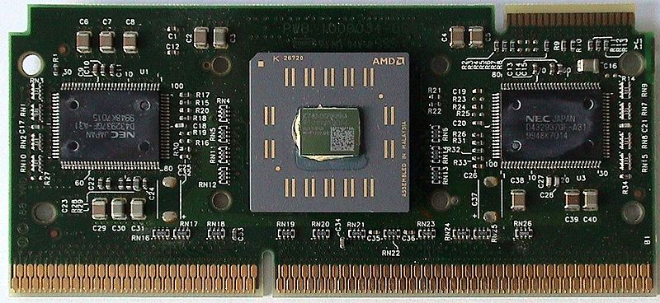
Desktop Components CISC CPU’s
x86 / x86–64
AMD
K5
K6
K7/Athlon (Slot A using Alpha EV6 bus)
K8/Opteron (HT and Memory Controller)
K10/Opteron/Phenom X3 X4/Turion II/Athlon II
K10 and Bobcat APU’s (GPU)
Bulldozer
VIA
Cyrix
Notes:
Athlon greek for contest
AMD VIA and Cyrix had poor FP until K7
August 1999, AMD released the Athlon (K7) processor. Design team was made up of DEC Alpha engineers and K5 and K6 veterans.
EV6(slot1) bus licensed from DEC/Compaq allowed the Athlon to use the rising edge as well as falling edge of the bus clock for transfers (DDR) thus making it the fastest bus at the time with 200MHz effectively
K7 allowed AMD to surpass Intel in FP performance

Slide 8
Desktop Components Chipsets
Integrated Circuit (IC) chips that controls the flow of data between the CPU and Memory and Peripherals
First PC chipset was for the Intel 80286
Traditionally split into two chips…Northbridge and Southbridge (Input/Output Controller Hub or ICH)
Northbridge linked the CPU to main memory and the graphics controller
Southbridge linked to slower peripherals on PCI slots
Optionally the Southbridge may contain on-chip functions such as Ethernet, USB, audio and storage
Notes:
Show intel ark
ICH I/O Controller Hub

Slide 9
Desktop Components Chipsets
Late 90’s and early 2000’s system speed was bottlenecked by the chipset
Front Side Bus speeds of 66MHz between the CPU and memory were also tied to the PCI slots
Overclocking your FSB could cause system instability in other components
Overclocking also increased the heat the Northbridge generated
Notes:
http://www.tomshardware.com/reviews/75,27.html
QPI and replaced FSB
Irongate
AMD developed two Alpha 21264-compatible chipsets, the Irongate, also known as the AMD-751, and its successor, Irongate-2, also known as the AMD-761. These chipsets were developed for their Athlon microprocessors but due to AMD licensing the EV6 bus used in the Alpha from Digital, the Athlon and Alpha 21264 were compatible in terms of bus protocol. The Irongate was used by Samsung in their UP1000 and UP1100 motherboards. The Irongate-2 was used by Samsung in their UP1500 motherboard.

Slide 10
Desktop Components Chipsets
1998 – Alpha 21364 (EV7) revealed to have integrated Direct Rambus DRAM memory Controller
1999 – AMD Athlon released with EV6 bus
2001 – EV7 released after 2 years of delays with IMCH and inter-CPU network controller
2003 – AMD introduced Athlon 64-bit (Opteron) processors with an integrated memory controller and inter-CPU connection (HyperTransport)
2007 – AMD Introduces K10 based products
2008 – Intel introduced Nehalem with integrated memory controller and QPI
Notes:
http://www.tomshardware.com/reviews/75,27.html
QPI replaced FSB
Irongate
AMD developed two Alpha 21264-compatible chipsets, the Irongate, also known as the AMD-751, and its successor, Irongate-2, also known as the AMD-761. These chipsets were developed for their Athlon microprocessors but due to AMD licensing the EV6 bus used in the Alpha from Digital, the Athlon and Alpha 21264 were compatible in terms of bus protocol. The Irongate was used by Samsung in their UP1000 and UP1100 motherboards. The Irongate-2 was used by Samsung in their UP1500 motherboard.

Slide 11
Desktop Components Chipsets
2010 – Intel Clarkdale included GMCH on package but off die
2011 – AMD Releases first APU Llano (K10 with Radeon HD6000 on die)
2011 – AMD releases Bulldozer with Modular cores
2011 – Intel Sandy Bridge released with GMCH on die with CPU
2012 – Intel Releases Ivy Bridge with Intel HD graphics
Late 2013 – AMD plans to release Kaveri (Steamroller arch)
Northbridge no longer needed and Southbridge now connected to CPU

Slide 12
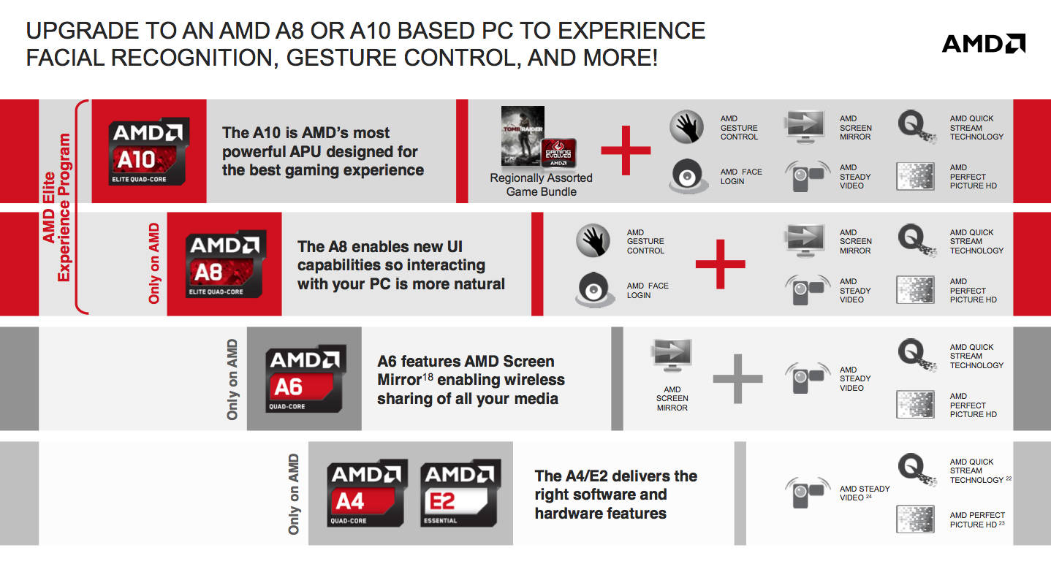
Desktop Components Chipsets
Notes:
http://www.tomshardware.com/reviews/75,27.html
QPI replaced FSB
Irongate
AMD developed two Alpha 21264-compatible chipsets, the Irongate, also known as the AMD-751, and its successor, Irongate-2, also known as the AMD-761. These chipsets were developed for their Athlon microprocessors but due to AMD licensing the EV6 bus used in the Alpha from Digital, the Athlon and Alpha 21264 were compatible in terms of bus protocol. The Irongate was used by Samsung in their UP1000 and UP1100 motherboards. The Irongate-2 was used by Samsung in their UP1500 motherboard.

Slide 13
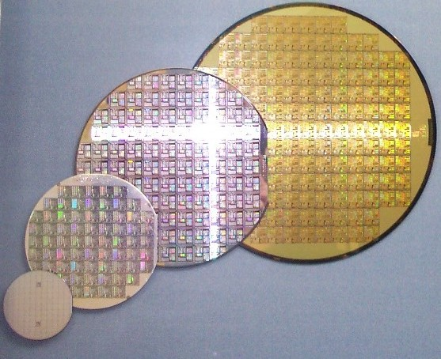
Desktop Components CPU’s – Manufacturing Process
Manufacturing of chips in “FABS”
“Baked” onto wafers
Ability to create smaller and smaller transistors and circuits
Leads to higher transistor counts and lower power usage
Gives company the ability to put more functionality on each chip – cores, cache, controllers, graphics
Intel has more advanced capabilities
AMD sold 3 core chips to increase yield from 4 core wafers
Notes:
AMD spun of its fabs to a new company called GlobalFoundries

Slide 14
Desktop Components CPU’s - Cache
Used by CPU to reduce access time to memory
DRAM up to 120ns
SRAM ~10ns
Stores recently used data for quick fetches
Cache was originally stored off chip on MB
L1 – First cache moved onto the chip die (486)
L2 – Name used for the (at the time) still-on-MB cache (Pentium Pro on package)
L3 – Socket 7 K6-II and K6-III had on chip L1 and L2 so MB cache was termed L3
Notes:
Alpha 21164 (EV5) was first chip to have large on-board L2 and a L3 on MB
introduction of SDRAM and the growing disparity between bus clock rates and CPU clock rates, which caused on-motherboard cache to be only slightly faster than main memory. Got rid of MB L3

Slide 15
Desktop Components CPU’s - Cache
Initial Athlons had L2 on package but off die
After manufacturing process shrink L2 was moved on die
Current processors have all 3 levels on die

Slide 16
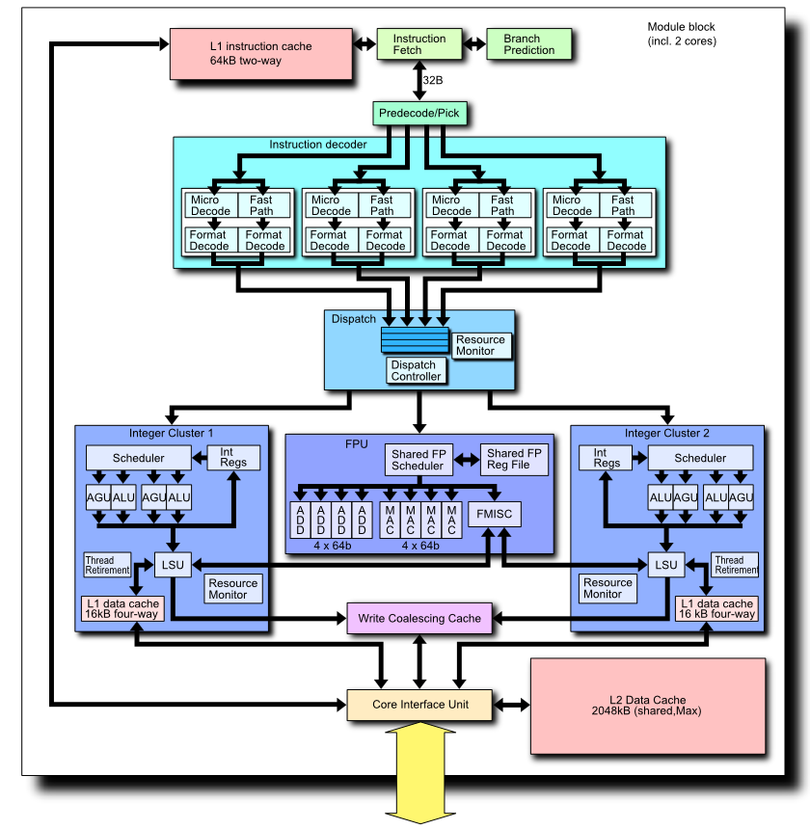
Desktop Components CPU’s - Cache
Cache Sharing
AMD K10 “modules” share L2 cache
“Module” are “Clustered Integer Cores”
Falls between Dual Core and SMT (HyperThreading)
Architecture developed by DEC in 1996 for 21264
AMD and Intel L3 cache shared among all cores
Intel Ivy Bridge 8 core and AMD Bulldozer 16 core
Roughly equal performance on highly threaded apps
Intel has SMT to process 16 threads on 8 cores
AMD has dual chips with 8 clusters

Slide 17
Desktop Components CPU’s - Extensions
Processor Supplementary Capability
Instruction Sets that extend the capabilities of the base architecture
Developers can make use of them at several levels
Kernel
Compile
Run Time
Give a competitive advantage and consumers a reason to upgrade
Examples:
MMX (MultiMedia eXtension) - Intel
3DNow! - AMD
SSE (Steaming SIMD (Single Instruction, Multiple Data) Extension) - Intel

Slide 18
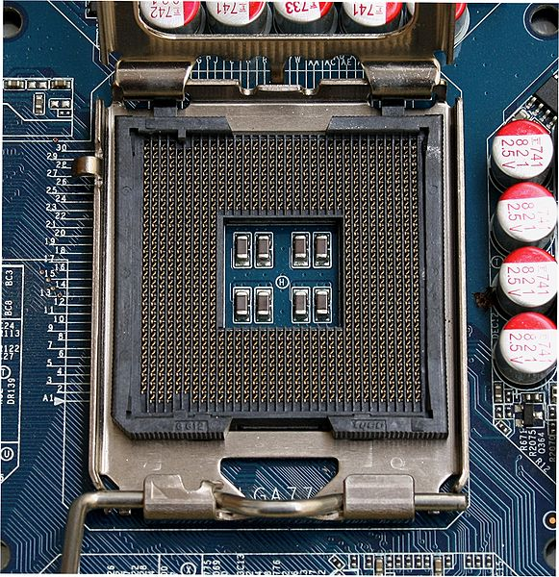
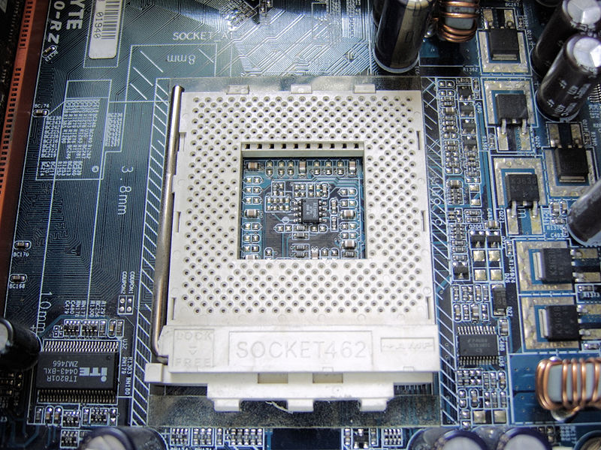
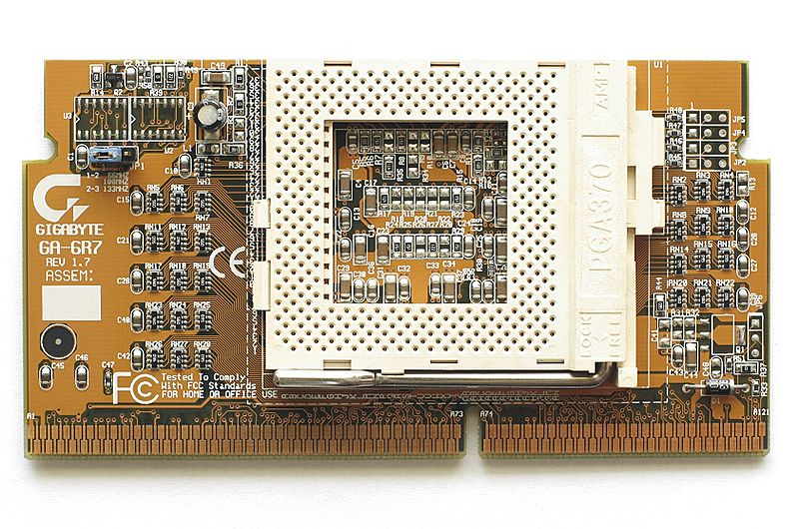
Desktop Components CPU’s - Sockets
Provides electrical and mechanical connection to motherboard
Keyed to ensure proper insertion
Clips or latches used to hold chip
Types
Socket
Slot
BGA (permanent mount)
Notes:
Socket A 462 pins
LGA 775
Slot to socket converter
Sockets changed to Zero insertion force (ZIF) as pin counts got higher
Slot 1/2 and Slot A/B
BGA embedded systems

Slide 19
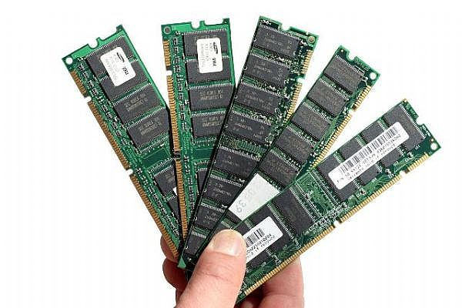
Desktop Components Memory
SIMMs
FPM (Fast Page Mode)
EDO (Extended Data Out)
BEDO (Burst EDO)
Too Late to market
DIMMs
SDR-SDRAM
RDRAM (Rambus)
DRDRAM (Direct Rambus)
Notes:
Rambus had higher latencies than standard ram and got into a standards war with DDR which it lost

Slide 20
Desktop Components Memory
DIMMs
DDR-SDRAM (DDR, DDR2, DDR3)
DDR SDRAM Standard | Bus clock (MHz) | Internal rate (MHz) | Prefetch (min burst) | Transfer Rate (MT/s) | Voltage | DIMM pins | SO-DIMM pins | uDIMM pins
DDR | 100–200 | 100–200 | 2n | 200–400 | 2.5/2.6 | 184 | 200 | 172
DDR2 | 200–533 | 100–266 | 4n | 400–1066 | 1.8 | 240 | 200 | 214
DDR3 | 400–1066 | 100–266 | 8n | 800–2133 | 1.5 | 240 | 204 | 214
Notes:
Internal rates havnt changed but the transfer rate doubles

Slide 21
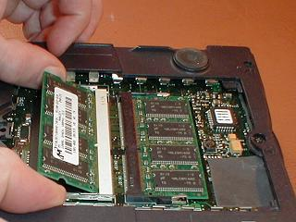
Desktop Components Memory
SO-DIMM (Small Outline)
Laptops
Embedded Systems
ECC vs Non-ECC
Cosmic Rays and Background radiation can cause a bit to flip
ECC enabled chips can scrub errors
Many system crashes may be caused by soft memory errors on NON-ECC systems
Low power

Slide 22
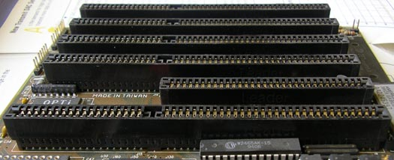
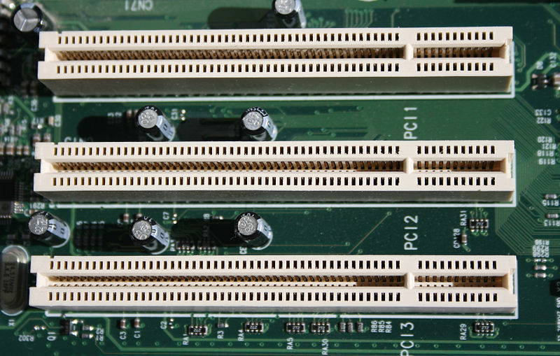
Desktop Components Bus
ISA
8bit - 4.77 MHz
16bit - 8 MHz
PCI (32bit)
33MHz
66MHz
Tied to the clock
PCI-X (64bit)
66MHz
133MHz

Slide 23
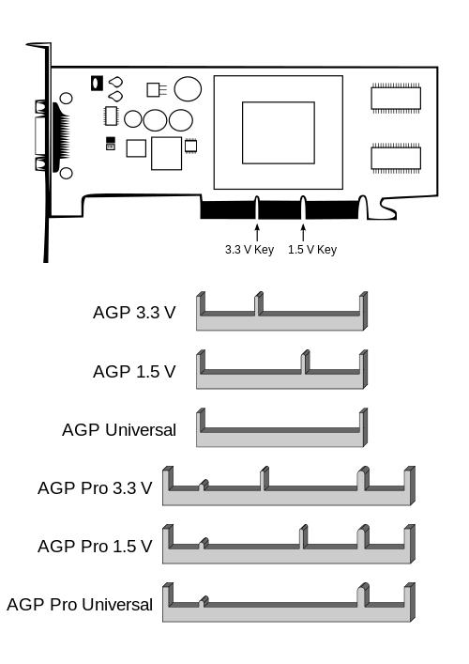
Desktop Components Bus
PCI-X 2.0
266MHz
533MHz
Rare and being replaced by PCI-E
AGP (Accelerated Graphics Port)
Dedicated bandwidth for Graphics
Can read textures directly from system memory
Versions 1.0 – 3.0
AGP Pro designed for workstations
AGP Pro caused some confusion for Desktop support

Slide 24
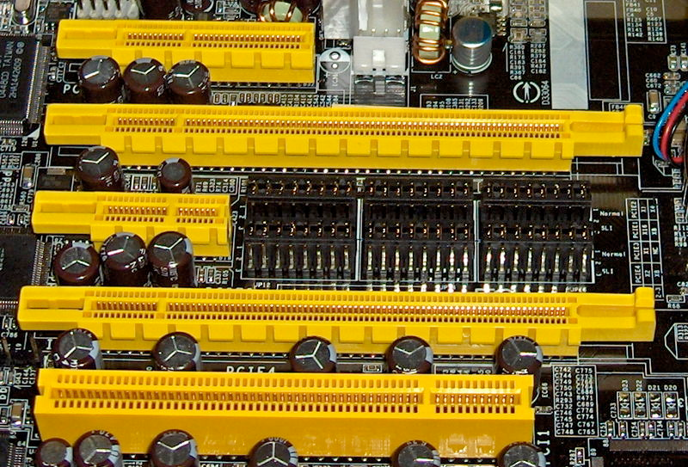
Desktop Components Bus
PCI Express (PCIe or PCI-E)
Better error detection
Native hot-plug functionality
x1 to x32 lanes
Smaller card will run in larger
Can have xSize (xWired mode)
Versions 1.0 – 3.0
PCIe Mini
Number of lanes dependent on number of CPU’s and type
Future 4.0 approx. 2014/2015

Slide 25
Desktop Components Bus
Profiles
Full-size card
Height of 107 mm (4.2 inches) and a depth of 312 mm (12.283 inches)
Half-length extension card (de facto standard)
Width: 0.6 inches (15.24 mm)
Depth: 6.9 inches (175.26 mm)
Height: 4.2 inches (106.68 mm)

Slide 26
Desktop Components Bus
Profiles
Low-profile (half-height) card
Height: 1.42 inches (36.07 mm) to 2.536 inches (64.41 mm)
Depth: 4.721 inches (119.91 mm) to 6.6 inches (167.64 mm)
Bracket height is reduced to 3.118 inches. The smaller bracket will not fit a standard PC case, but will fit in a 2U rack-mount case.
Many manufacturers supply both types of bracket (brackets are typically screwed to the card so changing them is not difficult).

Slide 27
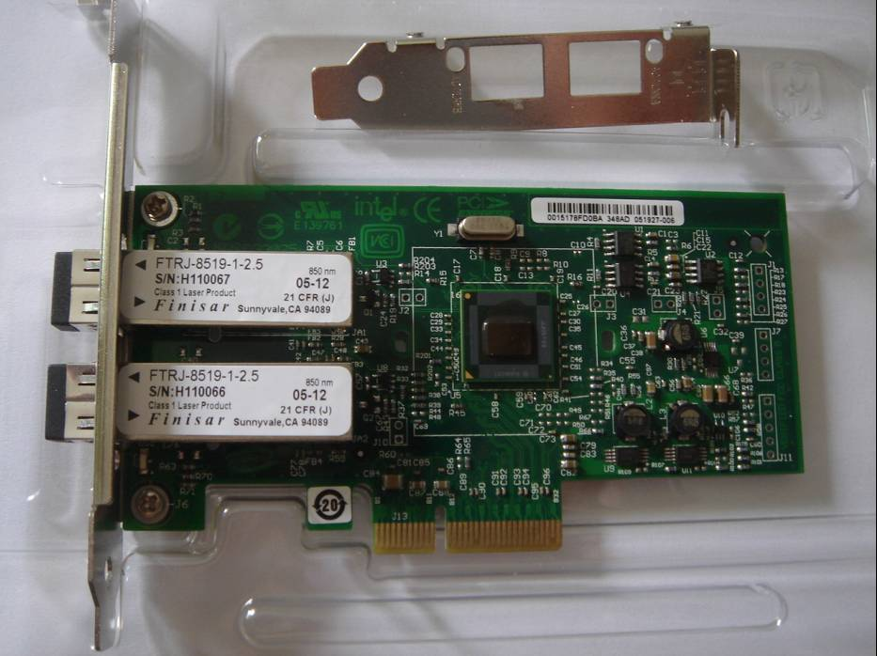
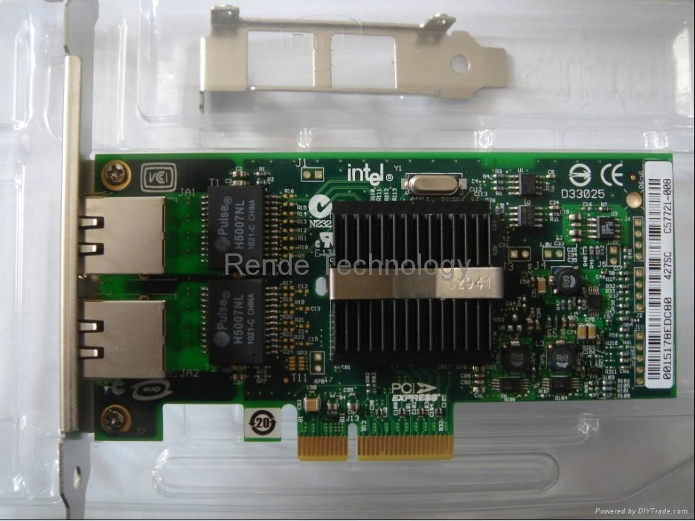
Desktop Components Networking
Chips
Intel
Broadcom
Speeds
10Mb
100Mb
1Gb
10Gb
Media
Copper
Fiber

